Slide 1
M O D U L E - 3

Slide 2
C O N T E N T S
Planning phase
Project planning objective
Software scope
Empirical estimation models
COCOMO
Single variable model
Staffing and personal planning
Design phase
Design process
Principles
Concepts
Effective modular design
Top down
Bottom up strategies
Stepwise refinement

Slide 3
P R O J E C T P L A N N I N G

Slide 4
I N T R O D U C T I O N
The software project management process begins with set of activities called project planning.
It is the heart of project life cycle, and informs all involved where to go and how to go.
It helps to manage time, cost, quality, changes, risk and related issues.

Slide 5
P U R P O S E O F P R O J E C T P L A N N I N G P H A S E
Establish business requirements.
Establish cost, schedule, list of deliverables and delivery dates.
Establish resource plans.
Obtain management approval and proceed to next phase.

Slide 6
B A S I C P R O C E S S O F P R O J E C T P L A N N I N G
(a) Software planning: specify in-scope requirement for project to facilitate creating work break down structure.
(b) Preparation of work breakdown structure: Break down the project into tasks and sub-tasks.
(c) Project schedule development: Listing the entire schedule of activities and sequence of implementation.
(d) Resource planning: It specifies who will do what, at which time and any special skill needed.
(e) Budget planning: It specifies cost to be incurred at completion of the project.

Slide 7
B A S I C P R O C E S S O F P R O J E C T P L A N N I N G
(f) Procurement planning: It focuses on vendors outside your company and sub-contracting.
(g) Risk management: It includes possible risks and solutions for them.
(h) Quality planning: It is assessing quality criteria to be used.
(i) Communication planning: It includes designing communication strategy with stakeholders.

Slide 8
Software Scope
It is the first step in project planning.
It should have function and performance details which is unambiguous and understandable at management and technical levels.
It describes data and control to be processed, function, performance, constraints, interfaces and reliability.
It addresses the following:
Function: Actions and information transformations performed by the system.
Performance: Processing and response time required.

Slide 9
Constraints: Limits placed over software like memory restriction.
Interfaces: Interaction with user and other system.
Reliability: Quantitative requirements for functional performance like mean time between failures, acceptable error rates.

Slide 10
P R O J E C T E S T I M A T I O N

Slide 11
I N T R O D U C T I O N
The main task involved in project planning is project estimation
Following project attributes are estimated
Cost
How much it is going to cost to develop the software product?
Effort
How much effort would be necessary to develop the product?
Duration
How long it is going to take to develop the product?

Slide 12
I N T R O D U C T I O N
The quality of project plan depends on the accuracy of estimates
Parameters considered are:-
Project size
Effort required to complete the project
Project duration
Cost
Accuracy of estimates is important
They help in quoting appropriate project cost to customer
Forms the basis for resource planning & scheduling

Slide 13
P R O J E C T E S T I M A T I O N T E C H N I Q U E S
3 techniques
Empirical estimation techniques
Heuristic techniques
Analytical estimation techniques

Slide 14
C O S T E S T I M A T I O N M O D E L S
The cost estimation models are broadly classified into two categories, which are listed below:
Algorithmic models:
Estimation in these models is performed with the help of mathematical equations, which are based on historical data or theory.
The various algorithmic models used are
COCOMO,
COCOMO II
Software equation.

Slide 15
C O S T E S T I M A T I O N M O D E L S
Non-algorithmic models:
Estimation in these models depends on the prior experience and domain knowledge of project managers.
Note that these models do not use mathematical equations to estimate cost of software project.
The various non-algorithmic cost estimation models are
Expert judgment,
Estimation by analogy etc.

Slide 16
C O C O M O M O D E L ( 1 )
The Constructive Cost Model (COCOMO) is a procedural software cost estimation model developed by Barry W Boehm.
COCOMO is used to estimate size, effort and duration based on the cost of the software
While estimating total effort for a software project, cost of development, management, and other support tasks are included.
In this model, size is measured in terms of thousand of delivered lines of code (KLOC).

Slide 17
C O C O M O M O D E L ( 3 )
In order to estimate effort accurately,
COCOMO model divides projects into three categories listed below:
Organic
Semi-detached
Embedded

Slide 18
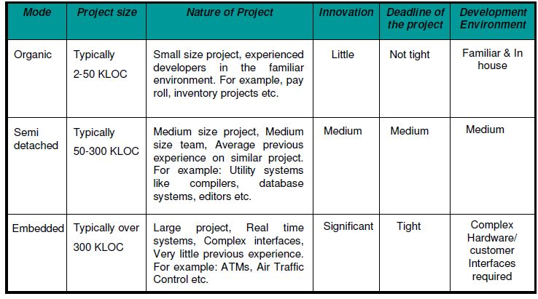
C O C O M O M O D E L ( 4 )

Slide 19
 | ORGANIC | SEMI-DETACHED | EMBEDDED
SIZE IN KLOC | 2-50 KLOC | 50-300 KLOC | More than 300 KLOC
SIZE OF PROJECT | Small | medium | large
EXPERIENCE | Experienced developers | Average experience | Very little experience
DEADLINE OF PROJECT | Not tight | medium | tight
ENVIRONMENT | Familiar | medium | complex

Slide 20
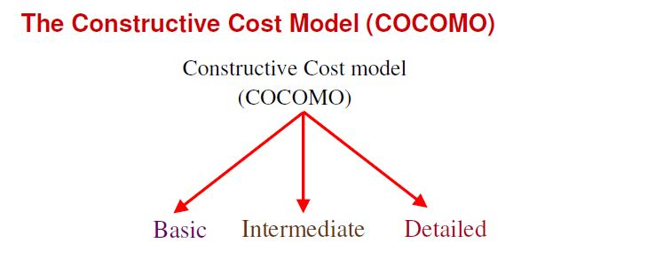
C O C O M O M O D E L ( 5 )
COCOMO is based on the hierarchy of three models, namely,
Basic Model
Intermediate Model
Advanced Model (Detailed)

Slide 21
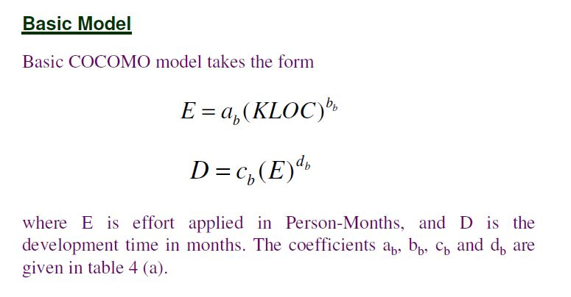
C O C O M O M O D E L ( 6 )
Effort: Amount of labor that will be required to complete a task. It is measured in person-months units.

Slide 22
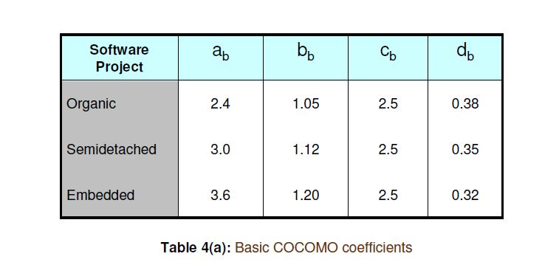
C O C O M O M O D E L ( 7 )

Slide 23
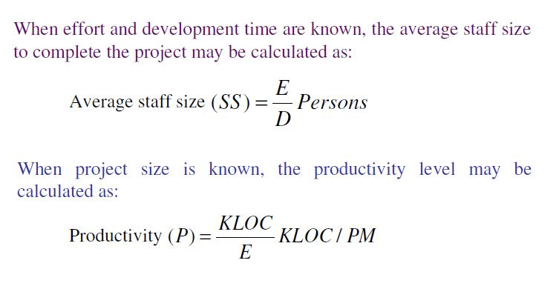
C O C O M O M O D E L ( 8 )

Slide 24
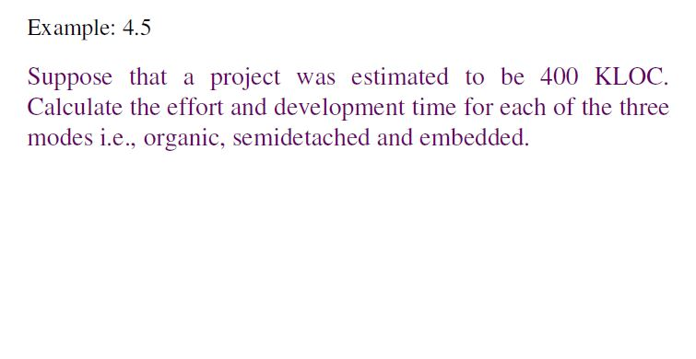
C O C O M O M O D E L ( 9 )

Slide 25
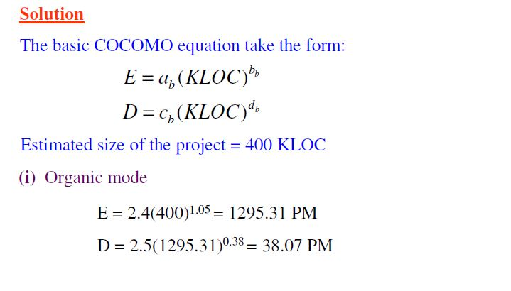
C O C O M O M O D E L ( 1 0 )

Slide 26
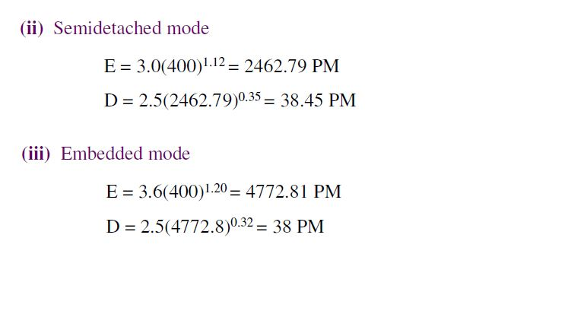
C O C O M O M O D E L ( 1 1 )

Slide 27
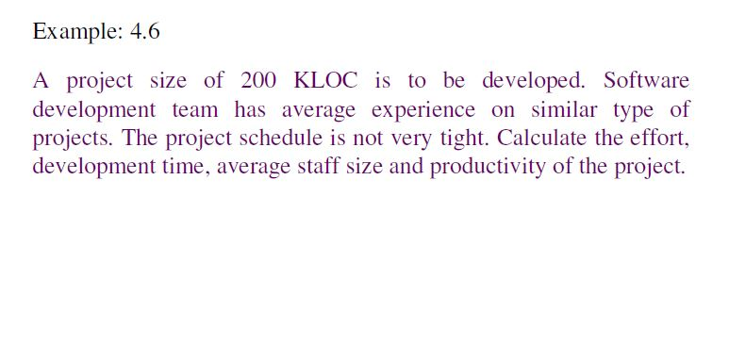
C O C O M O M O D E L ( 1 2 )

Slide 28
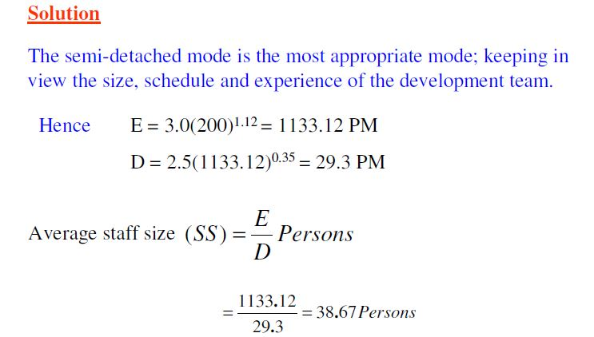
C O C O M O M O D E L ( 1 3 )

Slide 29
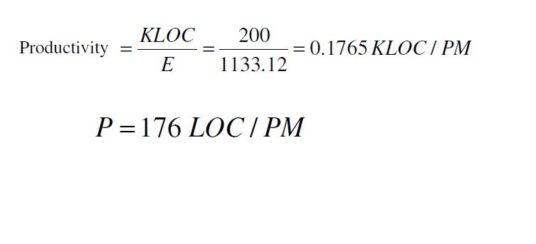
C O C O M O M O D E L ( 1 4 )

Slide 30
EXAMPLE 4
An air traffic control project of size 500 KLOC is to be developed. Software project team has very little experience on similar projects and the project schedule is also tight. Calculate the effort, development time, average staff size and productivity of the project

Slide 31
INTERMEDIATE MODEL
In intermediate model, parameters like software reliability and software complexity are also considered along with the size, while estimating effort.
Total effort = EAF × Ei
To estimate total effort in this model, a number of steps are followed, which are listed below:
1. Calculate an initial estimate of development effort by considering the size in terms of KLOC.
2. Identify a set of 15 parameters, which are derived from attributes of the current project.
All these parameters are rated against a numeric value, called multiplying factor. Effort adjustment factor (EAF) is derived by multiplying all the multiplying factors with each other.
3. Adjust the estimate of development effort by multiplying the initial estimate calculated in step 1 with EAF.

Slide 32
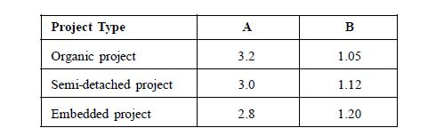
INTERMEDIATE MODEL
The value of constants ‘A’ and ‘B’ depend on the type of software project (organic, embedded, and semi-detached).

Slide 33
INTERMEDIATE MODEL
Fifteen parameters are identified.
These parameters are called cost driver attributes, which are rated as very low, low, nominal, high, very high or extremely high.
For example, in Table 2.12, reliability of a project can be rated according to this rating scale.
In the same Table, the corresponding multiplying factors for reliability are 0.75, 0.88, 1.00, 1.15 and 1.40.

Slide 34
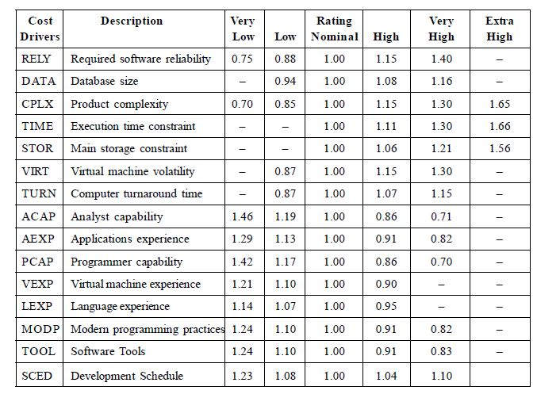
Intermediate Model

Slide 35
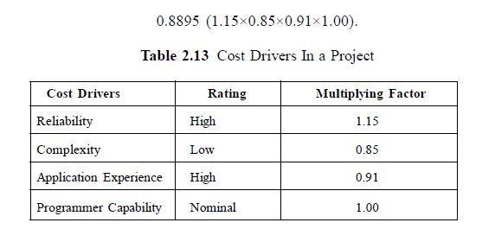
Intermediate Model

Slide 36
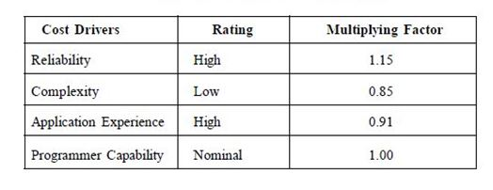
EXAMPLE
An organic project whose size is 45 KLOC is considered. Estimate total effort in this model

Slide 37
Total effort = Ei × EAF
An initial estimate is calculated with the help of effort equation
Ei = A × (size) B
Using the equation and the value of constant for organic project, initial effort can be calculated as follows:
Ei = 3.2 × (45) 1.05 = 174 PM
where Ei is the estimate of initial effort in person-months and size is measured in terms of KLOC.

Slide 38
Effort adjustment factor (EAF) is derived by multiplying all the multiplying factors with each other

Slide 39
INTERMEDIATE MODEL
Once EAF is calculated, the effort estimates for a software project is obtained by multiplying EAF with initial estimate (Ei).
To calculate effort use the following equation:
Total effort = Ei × EAF
Total effort = 174 × 0.8895
=155 PM.

Slide 40
ADVANCE MODEL
In advance model, effort is calculated as a function of program size and a set of cost drivers for each phase of software engineering.
This model incorporates all characteristics of the intermediate model and provides procedure for adjusting the phase wise distribution of the development schedule.

Slide 41
Advance Model
There are four phases in advance COCOMO model namely,
Requirements planning and product design (RPD)
Detailed design (DD)
Code and unit test (CUT)
Integration and test (IT)
In advance model, each cost driver is rated as very low, low, nominal, high, and very high.
For all these ratings, cost drivers are assigned multiplying factors.
Multiplying factors for analyst capability (ACAP) cost driver for each phase of advanced model are listed in Table
Note that multiplying factors yield better estimates because the cost driver ratings differ during each phase.

Slide 42
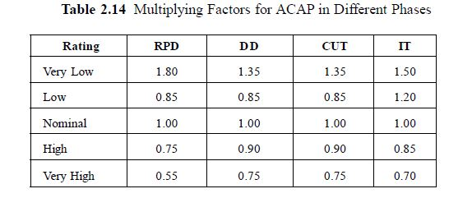
Advance Model

Slide 43
INTERMEDIATE MODEL
The value of constants ‘A’ and ‘B’ depend on the type of software project (organic, embedded, and semi-detached).

Slide 44
example
Software project (of organic project type), with a size of 45 KLOC and rating of cost driver as nominal is considered (That is 1.00).Calculate Effort for code and unit test phase CUT in this example, only cost drivers are considered.

Slide 45
answer
Initial effort can be calculated by using equation
Ei = 3.2 × (45)1.05 = 174 PM
Using the value of Ei,
final estimate of effort can be calculated by using the following equation:
E = Ei × rating of cost driver
E = 174×1
That is, E = 174 × 1 = 174 PM

Slide 46
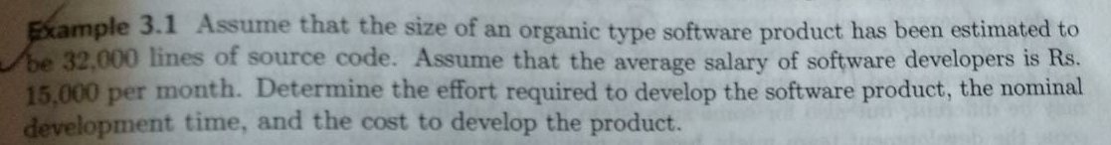

Slide 47
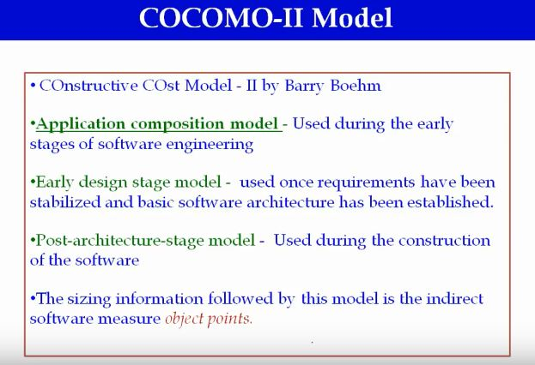

Slide 48
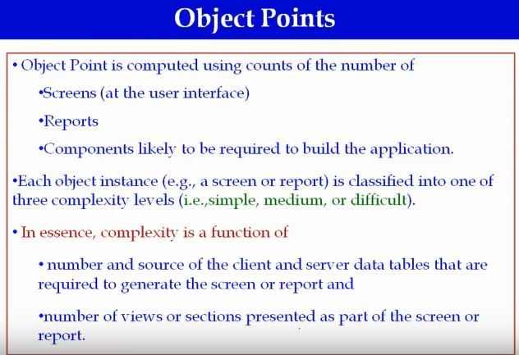

Slide 49
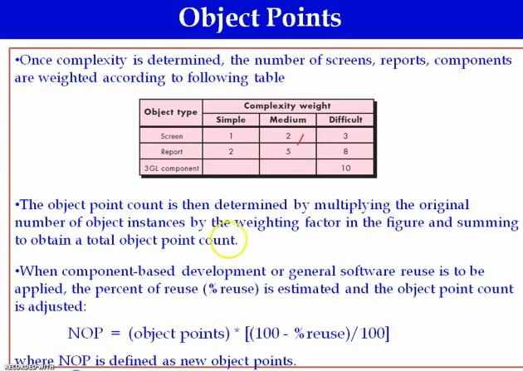

Slide 50
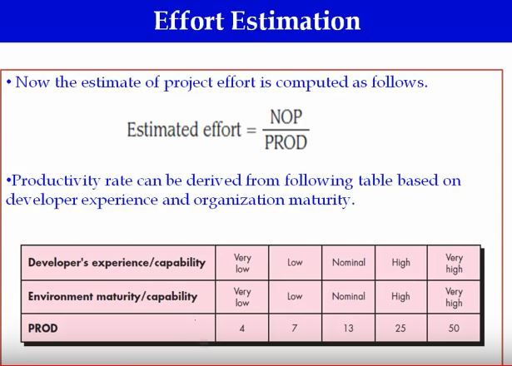

Slide 51
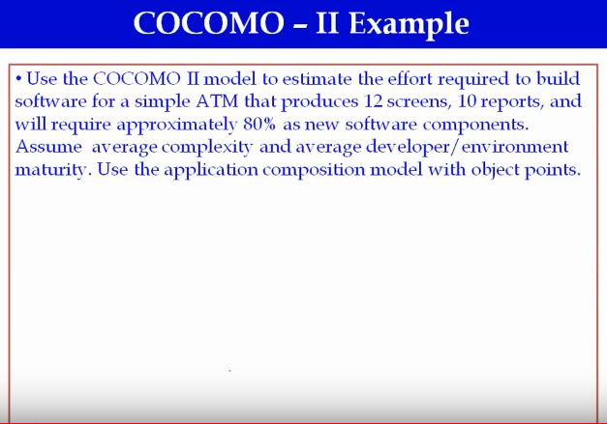

Slide 52
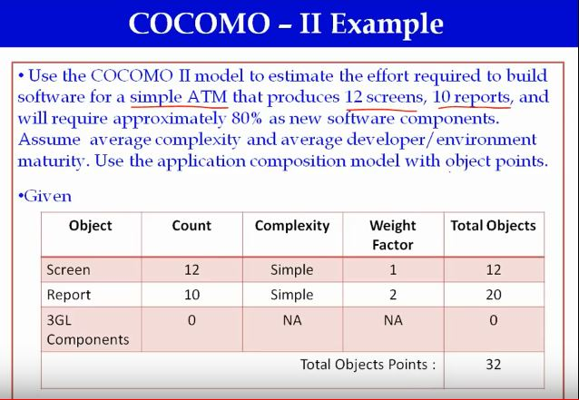

Slide 53
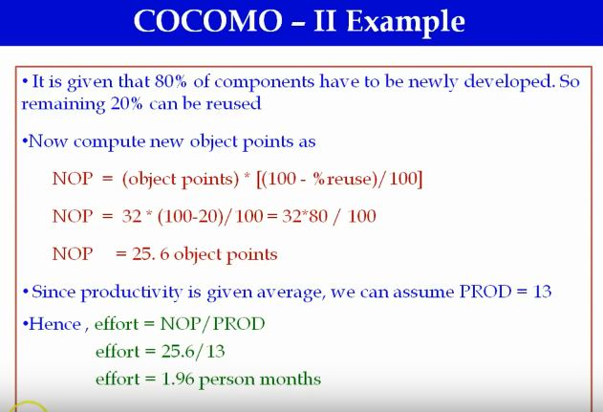

Slide 54
STAFFING AND PERSONAL PLANNING
Staffing is a practice of finding, evaluating and establishing a working relationship with future colleagues on a project and firing them when they are no longer needed.
Staffing involve finding people, who may be hired or already working for company (organization) or may be working for competing companies
Staffing must be done in a way that maximizes the creation of some values to a project.

Slide 55
Staffing and personal planning(2)
Staffing is performed according to the following rules
A person can only allocated to an activity if he or she possesses at least all characteristics demand by the activity, in an intensity level greater or equal to the demanded
A person can only allocated to an activity if he or she is available to perform the activity in the period its needs to be performed

Slide 56
Staffing activity for a software project
Selecting and training people for positions in the organization
Fill the organizational positions select, recruit or promote qualified people for each project position
Educate or train personal as necessary make up deficiencies in a position qualification through training and education
Provide for general development of the project staff improve knowledge, attitudes and skills of project personnel

Slide 57
Staffing activity for a software project (2)
Evaluate and appraise project personnel record and analyze the quantity and quality of project work as the basis of personnel evaluation, set performance goal and appraise personnel periodically
Compensate the project personnel provide wages, bonus ,benefits or other financial remuneration commensurate with project responsibilities and performance

Slide 58
Issues In Staffing
Lack of project management training
Greatly varying skills
Inability to predict productivity to engineers
Lack of experience
Not enough software engineers
Most graduates are theoretical
Or just coders

Slide 59
PERSONNEL PLANNING
This include estimation or allocation of right personal individuals for the right type of tasks of which they are capable.
The capability of individuals should always match with the overall objective of the project.
In software engineering personal planning should be in accordance to the final development of the project

Slide 60
S O F T W A R E D E S I G N

Slide 61
INTRODUCTION
In this phase, the design document is produced based on the customer requirements documented in SRS document
Objectives
Design process transforms SRS document into design document
Activities in the design phase is called design process

Slide 62
Overview of design process
Following items are designed & documented during design phase
Modules required
Control relationship among modules
Interfaces among modules
Data structures of the individual modules
Algorithms required to implement the individual modules

Slide 63
Modules required
The modules required in the project are identified
Each module consist of a collection of functions and the data shared by the functions
Each module performs a well defined task
Each module is named according to the task it performs

Slide 64
CONTROL RELATIONSHIP AMONG THE MODULES
Control relationship between 2 modules occurs due to function calls across 2 modules
These control relationships are identified in the design phase & it should be documented in the design document

Slide 65
INTERFACES AMONG THE MODULES
Interfaces among the modules specifies the data items exchanges between them
Data items are exchanged when one module invokes a function of other modules

Slide 66
Data structures of individual modules
Each module needs to store the data required for the function performed by that modules
Data structures are designed & documented in this phase to store & manage these data used in the modules

Slide 67
ALGORITHMS REQUIRED TO IMPLEMENT INDIVIDUAL MODULE
Each module performs a particular activity
Algorithms required to perform these activities are designed & documented in this phase
While designing an algorithm, considerations are given to accuracy of results, space & time complexity

Slide 68
CLASSIFICATION OF DESIGN ACTIVITIES
2 types of activities
Preliminary design (high level design)
Detailed design
Meaning & scope of these design activities varies according to the design methodology used
Design methodologies
Function-oriented approach
Object oriented approach

Slide 69
HIGH LEVEL DESIGN
High level design decomposes a problem into set of modules
Identifies the control relationships & interfaces among the modules
The outcome of high level design is called program structure or software architecture
The outcome of high level design is represented using notations

Slide 70
HIGH LEVEL DESIGN
Notation used in function-oriented approach to describe design is a tree like structure called structure chart
The outcome of high level design developed using object oriented approach is represented using UML notations

Slide 71
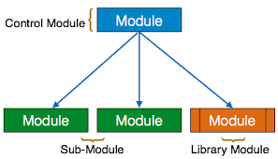
Structure chart

Slide 72
DETAILED DESIGN
Each module is examined carefully to design its data structure & algorithms
The outcome of detailed design is documented in the form of module specification document(MSPEC)
Data structures & algorithms used in MSPEC is grasped by the programmers to initiate coding

Slide 73
DESIGN ANALYSIS
To obtain a good design, first we have to perform an analysis
Goal of analysis
Elaborate the customer requirements through careful thinking
The analysis model is represented graphically

Slide 74
DESIGN ANALYSIS [2]
In function oriented approach,
Analysis model is represented using DFD
Design model is represented using structure chart
In object oriented approach
Analysis model➔ UML
Design model➔ UML
Design model is obtained from analysis model through a series of steps

Slide 75
CHARACTERISTICS OF GOOD S/W DESIGN
Correctness
A good design should be correct
It should correctly implement all functionalities of the system
Understandability
A good design should be understandable to the programmers
If it is not, then its difficult to maintain & implement it

Slide 76
CHARACTERISTICS OF GOOD S/W DESIGN
Efficiency
A good design should address resource, time and cost optimization issues
Maintainability
A good design should be easy to change

Slide 77
D E S I G N P R O C E S S

Slide 78
Introduction
Software design is an iterative process
Requirements are translated into a “blueprint” for constructing the software.
Initially, the blueprint depicts a holistic view of software
As iterations occur, subsequent refinement of the design occurs

Slide 79
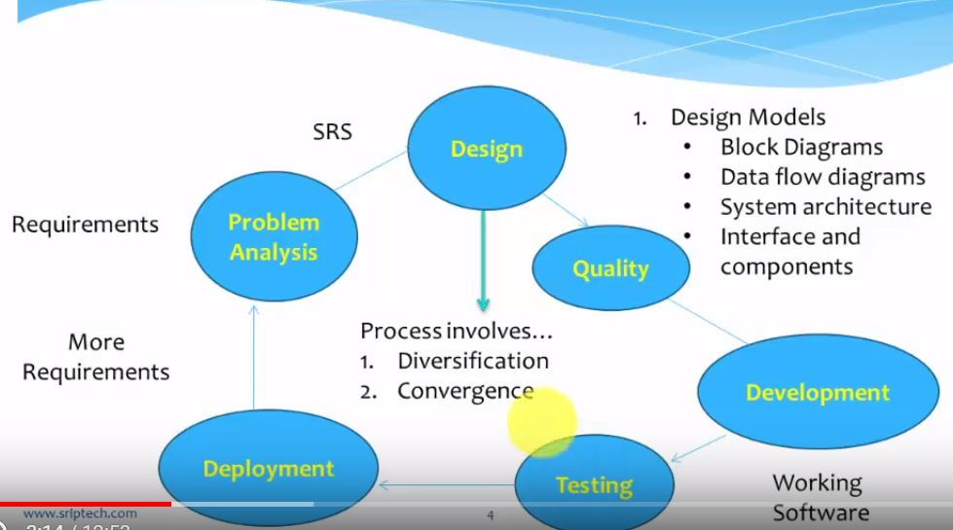
Design process

Slide 80
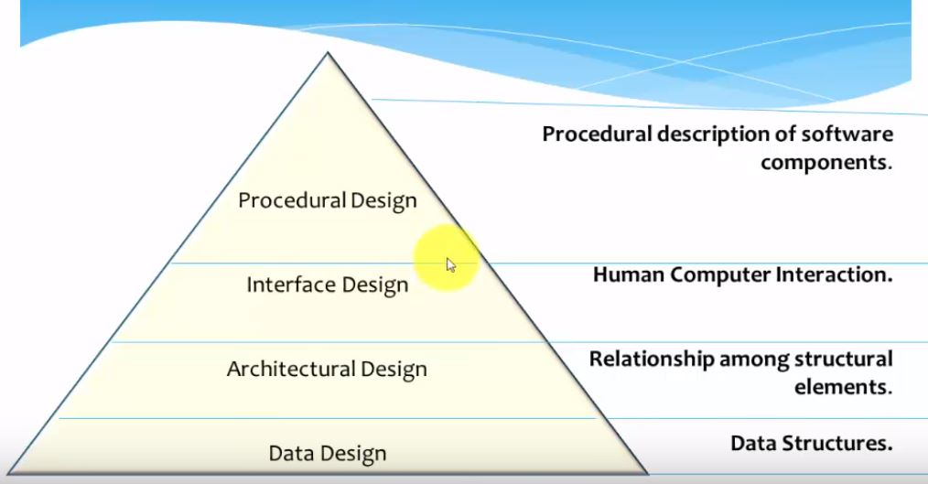
Design models

Slide 81
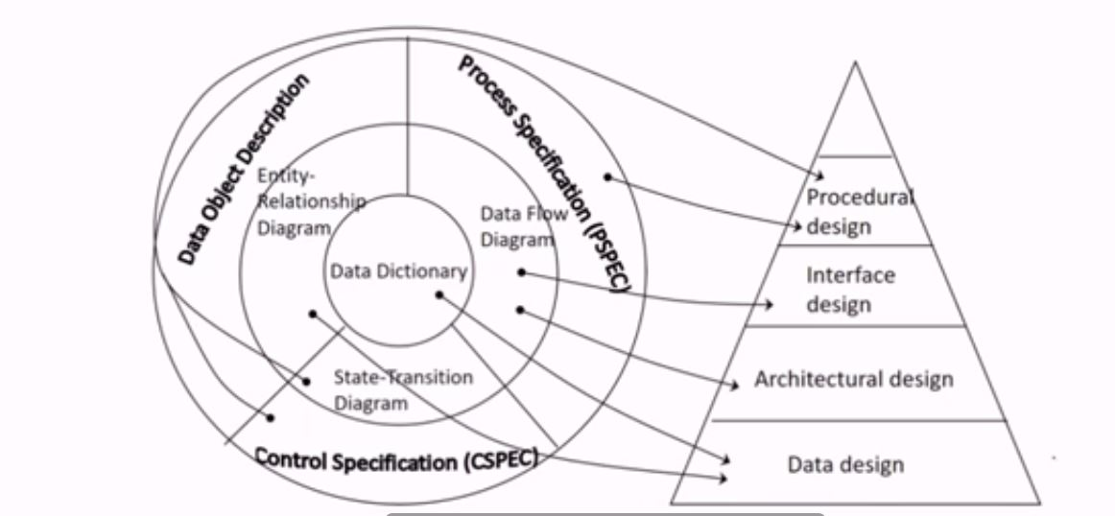
Translation model
Translation of analysis model into software design model

Slide 82
Design principles
Design principles enable the software engineer to navigate the design process
Design process should not suffer from “tunnel vision”
Design should be traceable to analysis model
The design should not reinvent the wheel
The design should “ minimize the intellectual distance” between the software and problem in the real world

Slide 83
Design principles (2)
The design should exhibit uniformity and integration
The design should be Structured to accommodate change

Slide 84
Design principles (3)
Design is not coding and coding is not design
The design should be assessed for quality as it is being created, not after the fact
The design should be reviewed to minimize conceptual errors

Slide 85
D E S I G N C O N C E P T S

Slide 86
DESIGN CONCEPTS
They provide the software designer with a foundation for creating a software design
Provide necessary framework for getting the right software design
Design concepts are:-
Abstraction
Architecture
Modularity
Information hiding
Functional independence
Refinement
Refactoring
Control hierarchy

Slide 87
ABSTRACTION
It is a technique to deal with the complexity of software
Complexity is reduced by giving the solution of a problem as different levels of abstraction
At high level of abstraction
a solution is stated in broad terms using the language of the problem environment.
At lower levels of abstraction,
a more detailed description of the solution is provided.

Slide 88
TYPES OF ABSTRACTION
Procedural abstraction
Data abstraction
A procedural abstraction refers to a sequence of instructions that have a specific and limited function.
The name of a procedural abstraction implies these functions
But specific details are suppressed

Slide 89
EXAMPLE
Open for a door.
Open implies a long sequence of procedural steps
walk to the door
reach out
grasp knob
turn knob
pull door
Step away from moving door, etc

Slide 90
Example
Data abstraction
A data abstraction is a named collection of data that describes a data object.
Eg: the data abstraction for door would encompass
A set of attributes that describe the door
door type
swing direction
opening mechanism
weight
dimensions

Slide 91
ARCHITECTURE
Software architecture specifies
The overall structure of the software
The structure or organization of program components (modules),
The manner in which these components interact,
The structure of data that are used by the components.

Slide 92
PROPERTIES SPECIFIED BY ARCHITECTURE
Structural properties
It define the components of a system (modules, objects, etc)
The manner in which those components are packaged and interact with one another
Extra-functional properties
It addresses, how the design architecture achieves requirements for
performance
capacity
reliability
security
adaptability
other system characteristics

Slide 93
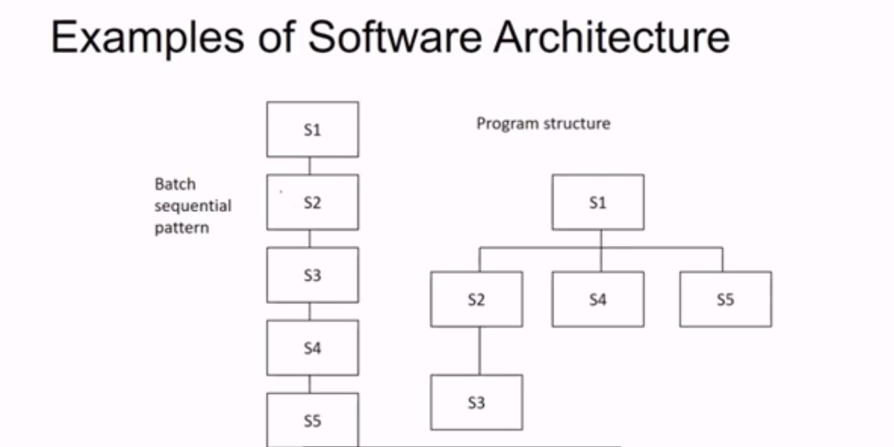

Slide 94
Architectural design models
Structural model
Framework model
Dynamic model
Process model
Functional model

Slide 95
STRUCTURAL MODEL
This model represents architecture as an organized collection of program components

Slide 96
Framework model
Framework models increase the level of design abstraction by
identifying repeatable architectural design frameworks (patterns) that are encountered in similar types of applications.

Slide 97
Dynamic model
It addresses the behavioral aspects of the program architecture,
It indicates how the structure or system configuration may change as a function of external events.

Slide 98
Process model
This model focus on the design of the business or technical process that the system must accommodate.

Slide 99
Functional models
These models can be used to represent the functional hierarchy of a system.

Slide 100
Modularity
Software is divided into separately named and addressable modules
“Divide and conquer” Approach –problem is broken into manageable pieces
Solution for the separate pieces then integrated into whole system

Slide 101
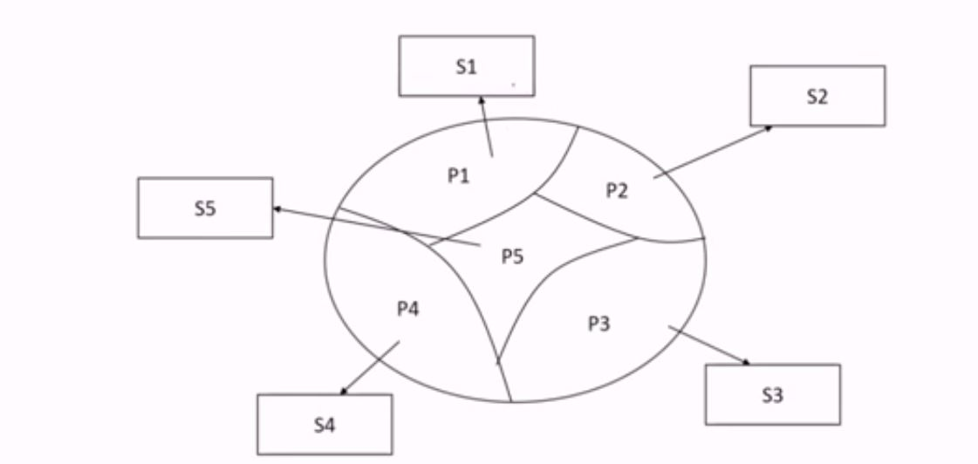
Divide and conquer

Slide 102
Information hiding
Modules should be specified and designed in such a way that
information (algorithms and data) contained within a module is inaccessible to other modules that have no need for such information.
This is called principle of information hiding

Slide 103
Advantages
Provides the greatest benefits when modifications are required during testing and maintenance.
Errors introduced during modification are less likely to propagate to other locations within the software.
Because most data and procedural detail are hidden from other parts of the software,

Slide 104
Functional independence
Design a module in such a way that it must address only a specific subset of requirements
It must have only a simple interface when viewed from other parts of the program structure.

Slide 105
Importance of functional independence
Independent modules are easier to develop
because function can be compartmentalized and interfaces are simplified
Easier to maintain and test
because secondary effects caused by design or code modification are limited
Error propagation is reduced
Reusable modules are possible.
Functional independence is a key to good design

Slide 106
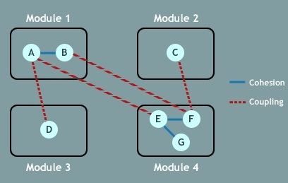
Criteria's used to evaluate functional independence
Cohesion
Cohesion is an indication of the relative functional strength of a module.
Coupling
Coupling is an indication of the relative interdependence among modules.

Slide 107
Cohesion
Cohesion is a natural extension of the information-hiding concept
A cohesive module performs a single task, requiring little interaction with other components in other parts of a program.
Stated simply, a cohesive module should (ideally) do just one thing.

Slide 108
Coupling
Coupling is an indication of interconnection among modules in a software structure.
Coupling depends on the interface complexity between modules,
It specifies the point at which entry or reference is made to a module,
what data pass across the modules

Slide 109
Coupling [2]
In software design, you should strive for the lowest possible coupling.
Low coupled modules are easy to understand
less prone to a “ripple effect”
caused when errors occur at one location and propagate throughout a system.

Slide 110
Refinement
It is a top-down design strategy originally proposed by Niklaus Wirth
An application is developed by successively refining levels of procedural detail.
Decompose a procedural abstraction in a stepwise fashion until programming language statements are reached.

Slide 111
Refinement is actually a process of elaboration.
It starts with a statement of function that is defined at a high level of abstraction.
The statement describes function or information conceptually
provides no indication of the internal workings of the function or the internal structure of the information.
Elaborate the original statement, by providing more and more details
Abstraction and refinement are contradictory concepts

Slide 112
Abstraction Vs refinement
Abstraction enables to specify procedure and data internally but suppress the need for “outsiders” to have knowledge of low-level details
Refinement helps to reveal low-level details as design progresses.
Both concepts allow you to create a complete design model as the design evolves.

Slide 113
Refactoring
Refactoring is a re-organization technique that simplifies the design of a component without changing its function or behavior.
It is a process of changing a software system in such a way that
it does not alter the external behavior of the code yet improves its internal structure.”

Slide 114
Steps in refactoring
The existing design is examined for
Redundancy
Unused design elements
Inefficient or unnecessary algorithms
Poorly constructed or inappropriate data structures
Any other design failure that can be corrected to yield a better design.

Slide 115
Advantages
Easy to integrate
Easy easier to test
Easier to maintain

Slide 116
Design classes
As the design model evolves, we have to define a set of design classes
that refine the analysis classes by providing design details
Create a new set of classes that implement a software infrastructure that supports the business solution.

Slide 117
Types of design classes
User interface class
Business domain class
Process class
Persistent class
System class

Slide 118
User interface class
Define all abstractions that are necessary for human-computer interaction (HCI)
Often implement the HCI in the context of a metaphor
Eg: check box, form, etc
Classes of interfaces may be visual representations of elements of metaphor

Slide 119
Business domain class
Identify the attributes and services (methods) that are required to implement some element of the business domain

Slide 120
Process class
Implement lower level business abstractions required to fully manage business domain classes

Slide 121
Persistent classes
Represents data stores that will persist beyond the execution of s/w

Slide 122
System classes
Implement s/w management & control functions that enable the s/m to operate & communicate within its computing environment & outside world

Slide 123
Control hierarchy
Control hierarchy is also called program structure
Hierarchy of modules representing the control relationship
A super-ordinate module control another module
Sub-ordinate module controlled by another module
Measure relevant to control hierarchy : depth, width, fan-in, fan-out

Slide 124
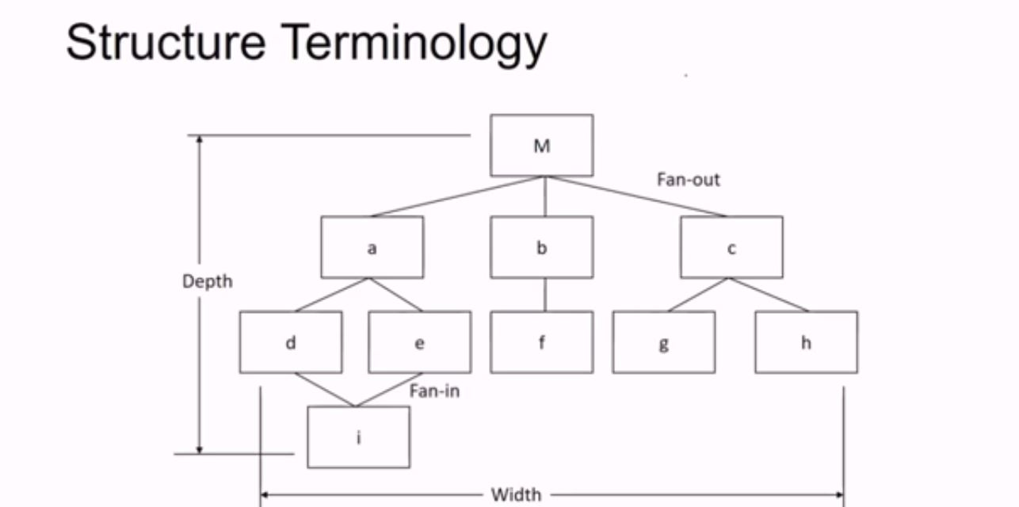

Slide 125
Control hierarchy
Depth - provide indication of number of levels of control
Width - overall span of control
Fan-out – measure of number of modules that are directly controlled by another module
Fan-in – indicate how many module directly control given module

Slide 126
EFFECTIVE MODULAR DESIGN

Slide 127
Introduction
A modular design is a design consisting of a set of modules that have only limited interactions with each other
If modules have no interactions with each other, then each module can be understood separately
This reduces the complexity of the design
Modularity is an important characteristic of a good design

Slide 128
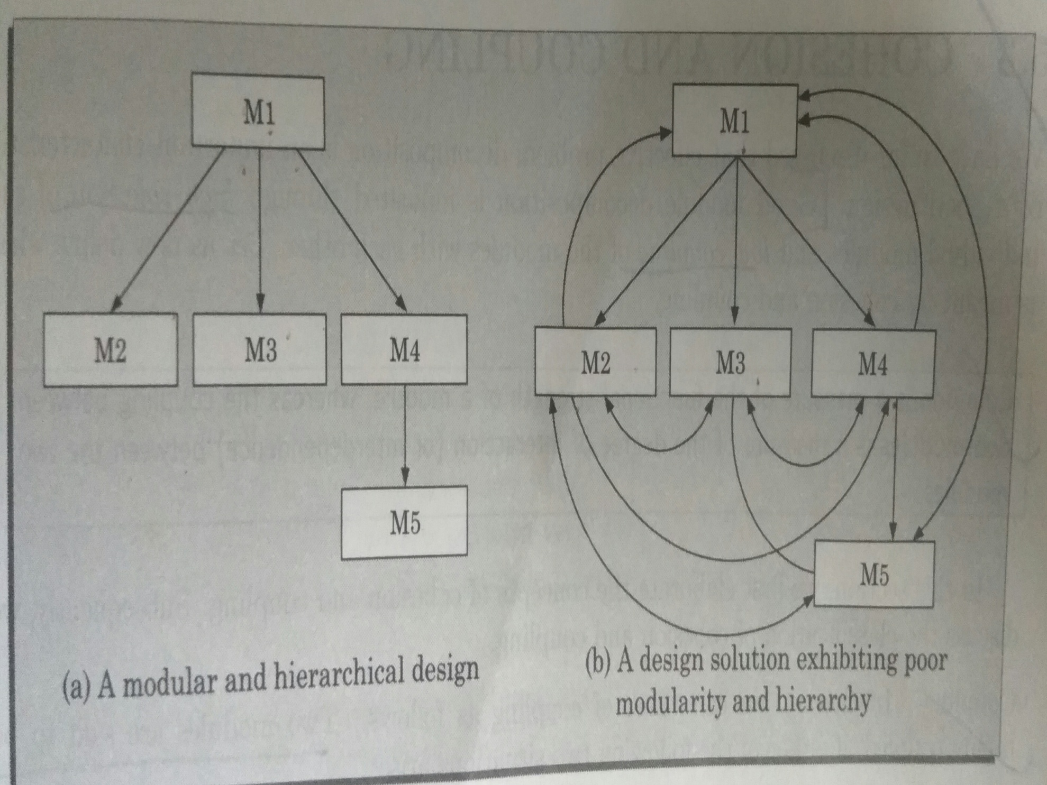

Slide 129
Desirable properties of a modular system
It consist of a well defined manageable units with well defined interfaces
Each module is a well defined subsystem
Each module has a single & well defined purpose
Modules are separately compiled & stored in a library
Modules must be easier to use
Modules must be simpler

Slide 130
Cohesion and coupling
Modularity of a design can be analyzed using two factors
Cohesion
Coupling
Cohesion is the measure of functional strength of a modules
Coupling is the measure of degree of interaction between the two modules

Slide 131
A design is said to be highly modular,
If the modules have high cohesion & low coupling
High coupling
2 modules are said to be highly coupled,
if they are strongly interconnected
They are highly dependent on each other
If the function calls between 2 modules involves passing of large chunks of shared data
If the interactions occur through some shared data
Low coupling
2 modules are said to have low coupling
If they do not interact with each other at all
If they are not dependent on each other

Slide 132
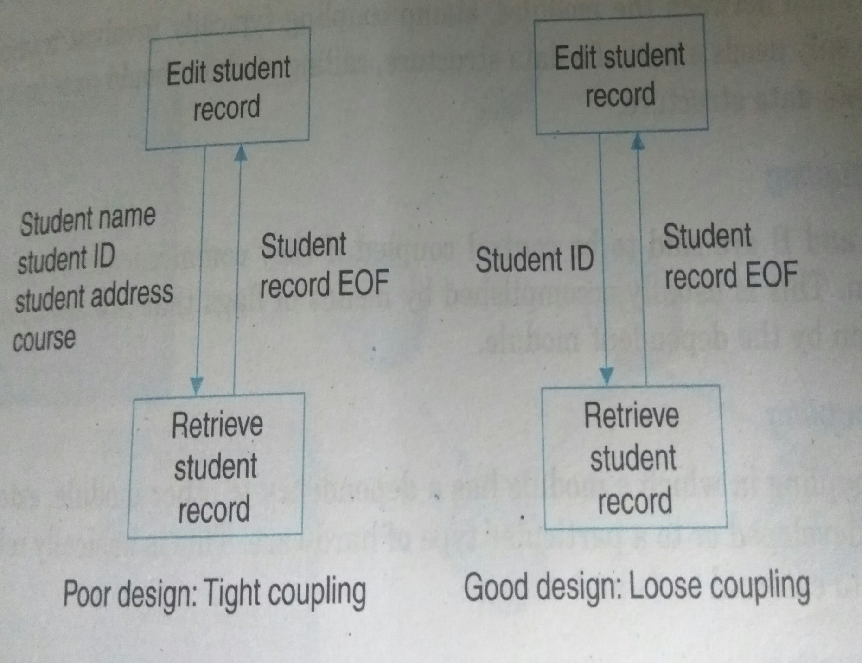
Cohesion and coupling

Slide 133
Steps to minimize coupling
Control the no: of parameters passed amongst modules
Avoid passing undesired data to calling module
Maintain parent child relationship between calling & called modules
Pass data, not the control information

Slide 134
Coupling
Coupling between 2 modules indicate inter-dependence between them
If 2 modules interchange large amount of data, then they are interdependent or coupled
Degree of coupling depends on interface complexity
Interface complexity is determined based on
the no: of parameters passed
complexity of parameters that are interchanged when one module invokes the functions of other module

Slide 135
Types of coupling
Data coupling
Stamp coupling
Control coupling
Common coupling
Content coupling
Data coupling has lowest coupling & content coupling has highest coupling

Slide 136
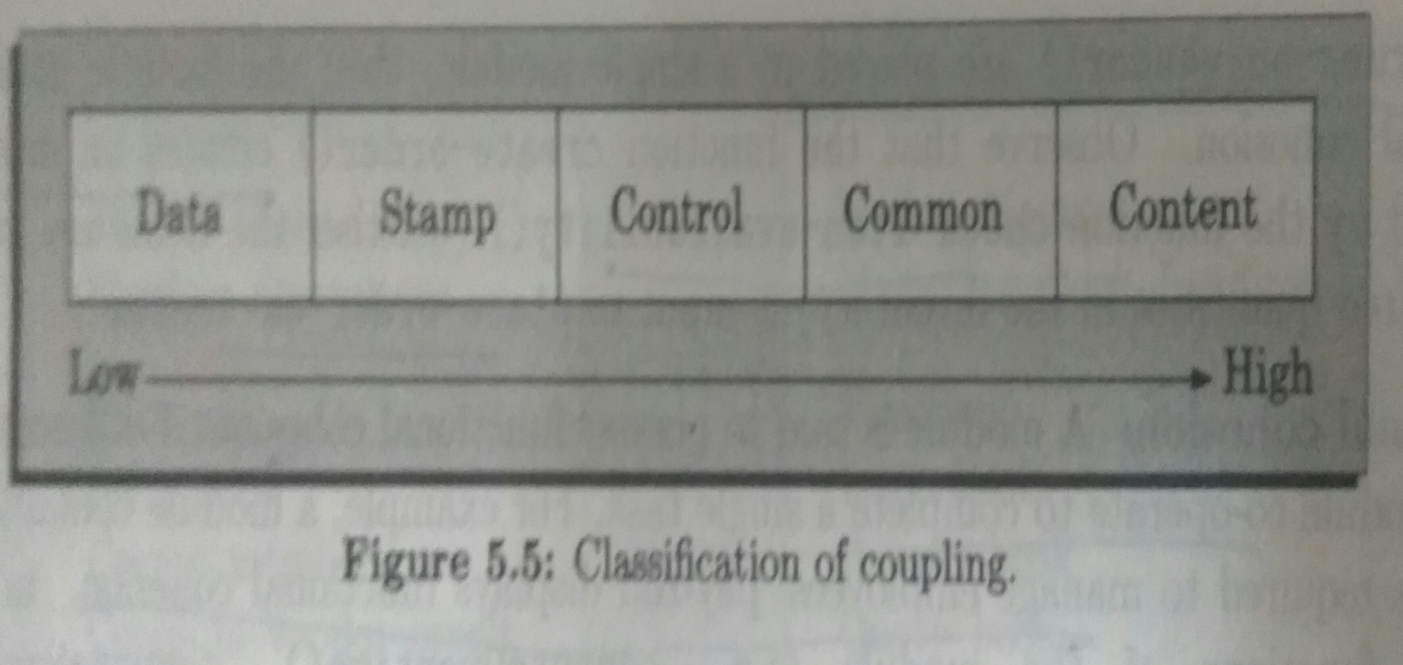
Types of coupling

Slide 137
Types of coupling
Data coupling
2 modules are data coupled, if they communicate using an elementary data item
This data item is passed as parameter between the two modules
Eg: integer
Float
character

Slide 138
Types of coupling
Stamp coupling
2 modules are stamp coupled if they communicate using a composite data item such as a structure or a record
Control coupling
Control coupling exists if data from one module is used to direct the order of instruction execution in another
Eg: Flag set in one module is tested in another module

Slide 139
Types of coupling
Common coupling
2 modules are common coupled if they share some global data items
Content coupling
This coupling exits between 2 modules, if they share code
Eg: jump from one module to the code of another module

Slide 140
Cohesion
Cohesiveness of the module is the degree to which different functions of the module cooperate to work towards a single objective
Good cohesion
If the functions of the module cooperate with each other for performing a single objective, then module is having good cohesion
Poor cohesion
If the functions of the module do different things and do not cooperate with each other to perform a single piece of work, then the module is said to have poor cohesion

Slide 141
Classification of cohesiveness
Coincidental
Logical
Temporal
Procedural
Communicational
Sequential
Functional
Coincidental class has worst cohesiveness
Functional has best cohesion

Slide 142
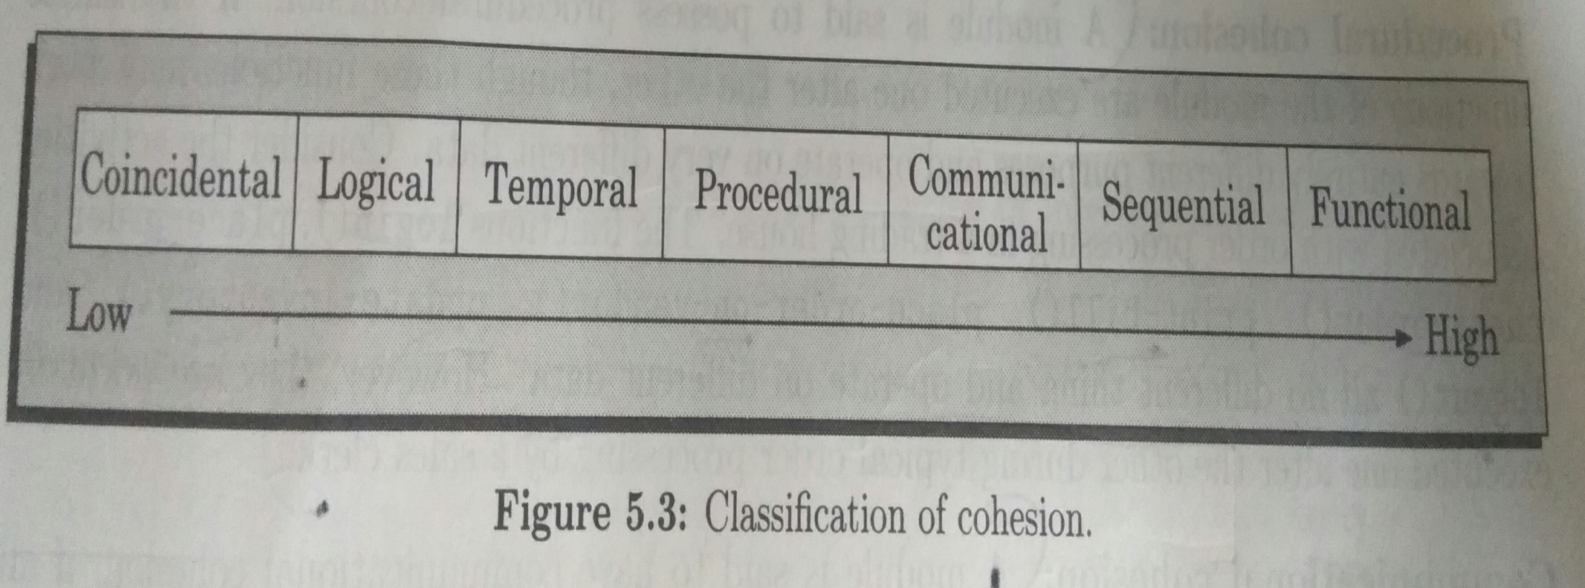
Classification of cohesiveness

Slide 143
Coincidental cohesion
A module is said to have coincidental cohesion if it performs a set of tasks that relate to each other very loosely
Module contains a random collection of functions
Functions are placed in the module out of coincidence rather than any thought
This happens if the design is made by novice programmers
Different functions of the module performs different unrelated activities

Slide 144
Logical cohesion
A module is logically cohesive if all elements of the module perform similar operations like
Printing grade sheets
Printing salary slips
Printing annual reports

Slide 145
Temporal cohesion
If a module contain functions that are executed in the same time span, then module is said to have temporal cohesion
Eg: During booting following functions are done
Initialization of memory
Loading the OS

Slide 146
Procedural cohesion
A module is said to be procedural cohesion, if the set of functions of the module are executed one after the other
Though these functions work differently and operate on different data, they execute one after the other
Eg: login
Place-order
Check-order
Print-bill
Place-order-on vendor
Update inventory
Logout

Slide 147
Communicational cohesion
A module is said to have communicational cohesion, if the functions of the module refer to or update same data structure
Eg: module: student
Admit student
Enter marks
Print grade sheet
All access the student record

Slide 148
Sequential cohesion
A module posses sequential cohesion, if different functions of a module execute in a sequence and o/p of one function is the i/p to the next in sequence

Slide 149
Functional cohesion
A module is said to posses functional cohesion, if different functions of the module cooperate to complete a single task
Eg: managing book issue: module
Function
Issue book
Return book
Query book
Find borrower

Slide 150
STRATEGY OF DESIGN

Slide 151
Introduction
Good system design strategy, organize program modules properly
This helps in easy development & maintenance
TYPES OF DESIGN STRATEGY
Bottom up design
Top down design

Slide 152
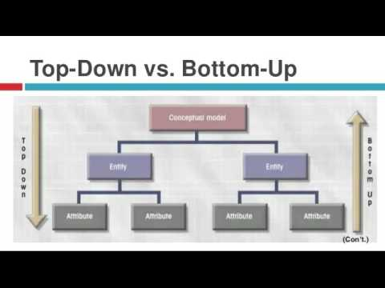

Slide 153
Bottom-up design
This approach identifies the modules that are required by many programs
These modules are collected together to form a library
These modules may be used by
Input- output functions
Graphical functions
In this approach we decide how to combine these modules to provide larger ones
These larger ones are again combined to one big module
Set of these modules form a hierarchy
Cross linked tree structure ➔ used to indicate subordinate modules

Slide 154
Bottom-up design [2]
Design progress from bottom layers to upwards
So its called as bottom up strategy
Strength
Coded module can be tested & design can be validated soon
Suitable for projects which are developed from existing s/m
Weakness
Intuitions are made to decide exactly what function a module provides
If our intuitions are wrong, then it may cause problems at higher level
This may lead to redesigning at lower level

Slide 155
Top-down approach
Approach starts by identifying major modules of the system
Decompose them into lower level modules
Iterate this process until the desired level of detail is achieved
This is a stepwise refinement
Starting from abstract design
On each step design is refined to more concrete level
Process is repeated until we reach a level where no more refinement is needed
Then design is implemented directly

Slide 156
Top-down approach [2]
Strength
Used in many design methodologies
Suitable if specifications are clear & if development is from scratch
Weakness
Nothing can be tested until all the subordinate modules are coded

